Slide 1
Programmable Interval Timer 8253 / 8254

Slide 2
WHY 8253 / 8254???
Not Possible To Generate Accurate Time Delays Using Delay Routines in 8086/8085
Intel’s Programmable Counter/ Timer Device (8253/8254) Facilitates
Accurate Time Delays
Minimizes Load On Mp
Real Time Clock
Event Counter
Digital One Shot
Square Wave Generator
Complex Waveform Generator

Slide 3
8253 vs 8254
8253
8254-ADVANCED VERSION OF 8253
8254 can operate with higher clock Frequency Range ( DC To 8 Mhz AND 10 Mhz FOR 8254-2)
Includes Status Read Back Command That Latches The Count And Status Of Counters
8253 can operate at frequency from dc to 2MHz

Slide 4
Compatible with All Intel and Most other Microprocessors and Handles Inputs from DC to 10 MHz
8 MHz 8254 and 10 MHz 8254-2
The Intel 8254 is a counter/timer device designed to solve the common timing control problems in microcomputer system design.
It provides three independent 16-bit counters, each capable of handling clock inputs up to 10 MHz
Binary or BCD counting
Single a +5V Supply and Standard Temperature Range
Six Programmable Counter Modes and All modes are software programmable. The 8254 is a superset of the 8253.
The 8254 uses HMOS technology and comes in a 24-pin plastic or CERDIP package.
Used for controlling real-time events such as real-time clock, events counter, and motor speed and direction control.

Slide 5
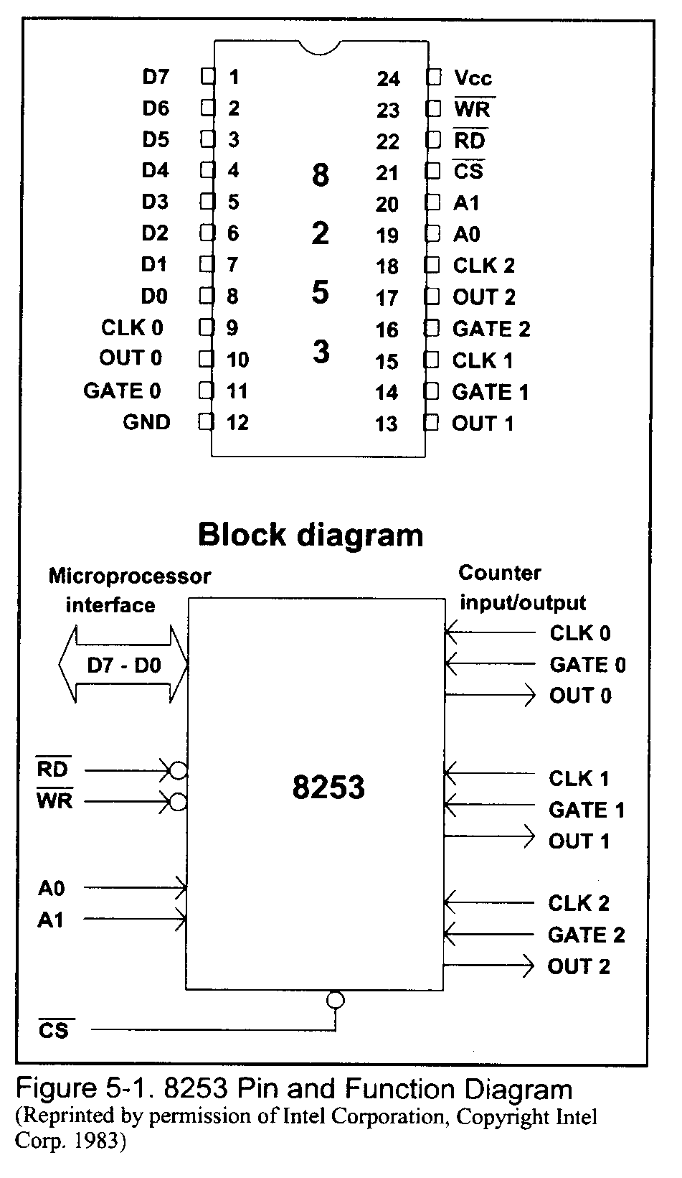

Slide 6
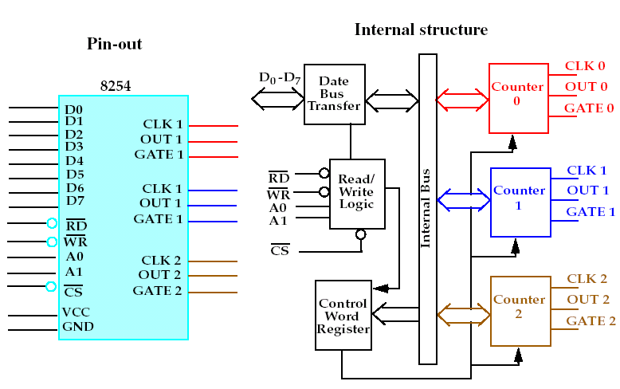

Slide 7
Counters:
Three Counters – C0,C1 & C2
Each 16 Bit Identical Presettable
Down Counter Operates In BCD /Hex
Controlled By Loading Count To Command Word Register
“On The Fly” Reading
Control Logic:
CS – Logic 0 – Enables 8254
RD – Logic 0 – Tells Microprocessor Reads Count From 8254
WR – Logic 0 – Tells Microprocessor Writes Count/ Command Into 8254
A1,A0 – Address Input Pins To Select CWR And Counters

Slide 8
Data Buffers:
8 Bit Bidirectional D0-d7 Connected To Data Bus Of Microprocessor
In → Reads Data From Peripheral
Out → Writes Data To Peripheral
Control Word Register:
Accepts 8 Bit Control Word Written By Microprocessor
Can Only Be Written ( Not Read)
Control Word Chooses One Of The Six Modes Of Operation

Slide 9
CS | RD | WR | A1 | A0 | OPERATION
0 | 1 | 0 | 0 | 0 | Write Counter 0
0 | 1 | 0 | 0 | 1 | Write Counter 1
0 | 1 | 0 | 1 | 0 | Write Counter 2
0 | 1 | 0 | 1 | 1 | Write Control Word
0 | 0 | 1 | 0 | 0 | Read Counter 0
0 | 0 | 1 | 0 | 1 | Read Counter 1
0 | 0 | 1 | 1 | 0 | Read Counter 2
0 | 0 | 1 | 1 | 1 | No Operation ( Tristated )
0 | 1 | 1 | X | X | No Operation ( Tristated )
1 | X | X | X | X | 8254 Not Selected

Slide 10
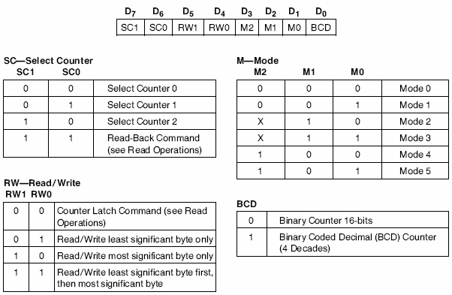
Control Word Format

Slide 11
8254 Modes Of Operation
Mode 0
Interrupt On Terminal Count
Mode 1 Programmable Monoshot
Mode 2 Rate Generator
Mode 3 Square Wave Generator
Mode 5 Hardware Triggered Strobe
Mode 4 Software Triggered Strobe

Slide 12
8254 Modes Of Operation
Mode 0 (Interrupt On Terminal Count )
Mode 1 (Programmable Monoshot )
Mode 2 (Rate Generator )
Mode 3 (Square Wave Generator )
Mode 4 (Software Triggered Strobe )
Mode 5 (Hardware Triggered Strobe )

Slide 13
Mode 0: Interrupt On Terminal Count
The output becomes a logic 0 when the control word is written remains low even after count value loaded in counter.
Counter starts decrementing after falling edge of clock
The OUT goes high upon reaching the terminal count & remains high till reloading OUT can be used as interrupt
Writing a count register , when previous counting is in process
→ first byte when loaded stops the previous count,
→ second byte when loaded starts new count
Gate high → normal counting
Gate low → counting terminated and current count latched till GATE goes high again

Slide 14
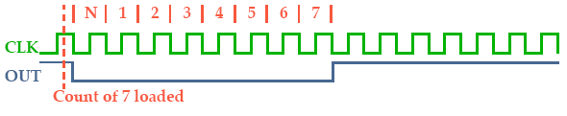
Mode 0: Interrupt On Terminal Count

Slide 15
Mode 1: One-shot mode.
Monostable multivibrator
Gate input is used as trigger input
Output remains high till the count is loaded after application of trigger, output goes low and remains low till count becomes zero
Another count loaded, when output already low →it does not disturb counting until a new trigger is applied at the gate
New counting starts after new trigger pulse

Slide 16
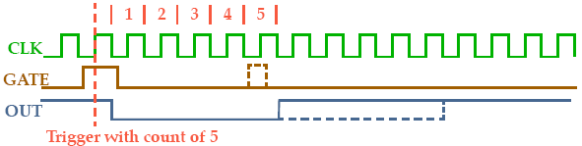
Mode 1: One-shot mode

Slide 17
Mode 2: Rate Generator / Divide by N Counter
When N is loaded as count → after N pulses → OUT goes low for only one clock cycle→ then, count N is reloaded → OUT becomes high for N clock pulses
The number of clock pulses between the two low pulses is equal to the count loaded
Gate → logic 0 → no counting
Gate → logic 1 → normal counting

Slide 18
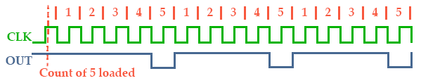
Mode 2: Rate Generator / Divide By N Counter

Slide 20
Mode 3: SQUARE WAVE RATE GENERATOR
When count N loaded is even → output remains HIGH for half the count and LOW for the rest half of the count
When count N loaded is odd → output remains HIGH for (N+1)/2 and low for (N-1)/2.
Repeated operation gives square wave
Generates a continuous square-wave with G set to 1.
If count is even, 50% duty cycle otherwise OUT is high 1 cycle longer.

Slide 21
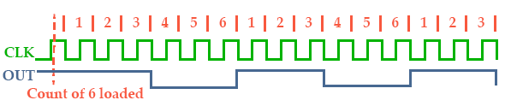
Mode 3: Square Wave Generator

Slide 22
Mode 4: Software triggered Strobe
After mode is set output goes high
When count is loaded counting down starts on reaching terminal count output goes low for only one clock cycle, and then again output goes HIGH
The above said low pulse can be used as a strobe for interfacing MP with peripherals
When GATE is LOW → counting is inhibited and count is latched
If a new count is loaded while counting, previous counting stops and new counting started in next clock cycle

Slide 23
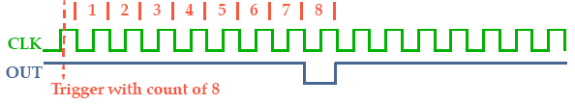
Mode 4: Software triggered Strobe

Slide 24
Mode 5: Hardware triggered Strobe
This mode generates a strobe in response to the rising edge at the trigger
Mode is used to generate a delayed strobe in response to an externally generated signal
Once mode is programmed and counter loaded, OUT goes HIGH
Counter starts counting after the rising edge of the trigger (GATE)
The OUTPUT goes LOW for one clock period, when the terminal count is reached
Output will not go LOW until the counter content becomes zero after the rising edge of any trigger
GATE is used as trigger input

Slide 25

Mode 5: Hardware triggered Strobe

Slide 26
Read Operations
There are three possible methods for reading the counters:
a simple read operation
the Counter Latch Command
the Read-Back Command
Simple read operation :
The Counter which is selected with the A1, A0 inputs, the CLK input of the selected Counter must be inhibited by using either the GATE input or external logic.
Otherwise, the count may be in the process of changing when it is read, giving an undefined result.

Slide 27
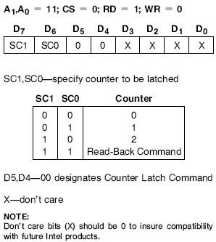
2. Counter Latch Command:
SC0, SC1 bits select one of the three counters
Two other bits, D5 and D4, distinguish this command from a control word
If a counter is latched and then, some time later, latched again before the count is read, the second counter latch command is ignored.
The count read will be the count at the time the first counter latch command was issued.

Slide 28
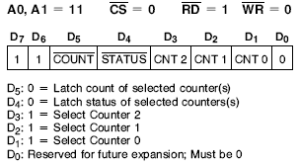
3. Read-back control command:
The read-back control, word is used, when it is necessary for the contents of more than one counter to be read at a same time.
Count : logic 0, select one of the Counter to be latched
Status : logic 0, Status must be latched to be read status of a counter and is accessed by a read from that counter

Slide 29
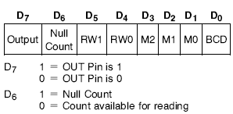
Status register:
Shows the state of the output pin
Check the counter is in null state (0) or not
How the counter is programmed

Slide 30
Example : Write a program to generate a square wave MODE 3 of 1KHz n frequency on OUT 1 pin of 8253/54. Assume CLK1 frequency is 1 MHz and address for control register = 0BH, counter 1 = 09H and counter 2 = 0AH.

Slide 31
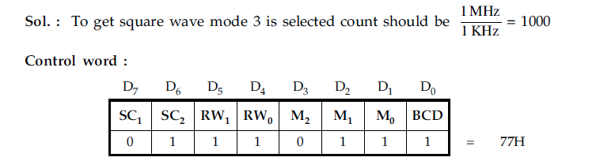

Slide 32
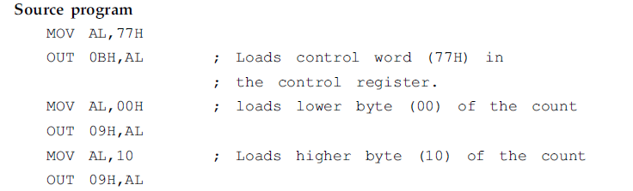

Slide 33
N=10 00
MVI A, 77H CW
OUT OBH CWR
MVI A,00 H LS B COUNT VALUE
OUT 09H COUNTER 1
MVI A,10H
OUT O9H COUNTER 1
HLT

Slide 34
Example:
Design a programmable timer using 8253 and 8085. Interface 8253 at an address 40H for counter 0 and write the following ALPs. The 8085 and 8253 run at 6 MHz and 1.5 MHz respectively,
1. To generate a square wave of period 1 ms.
2. To interrupt the processor after 10 ms.
3. To derive a mono shot pulse with quasi stable state
duration 5 ms.

Slide 35
Solution:
Neglecting the higher order address lines (A16-A8) the interfacing circuit diagram is shown in Fig.
The 8253 is interfaced with lower order data bus
(D0-D7), hence A0 is used for selecting the even bank. The A0 and A1 of the 8253 are connected with A1 and A2 of the processor.
The counter addresses can be decoded as given below.
If A0 is 1, the 8253 will not be selected at all.

Slide 36
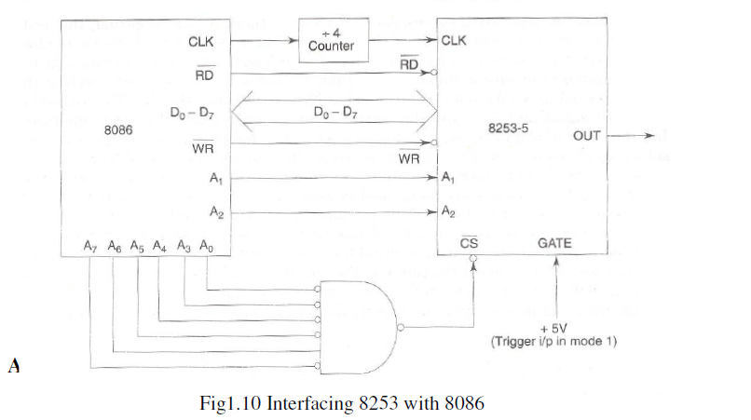

Slide 37
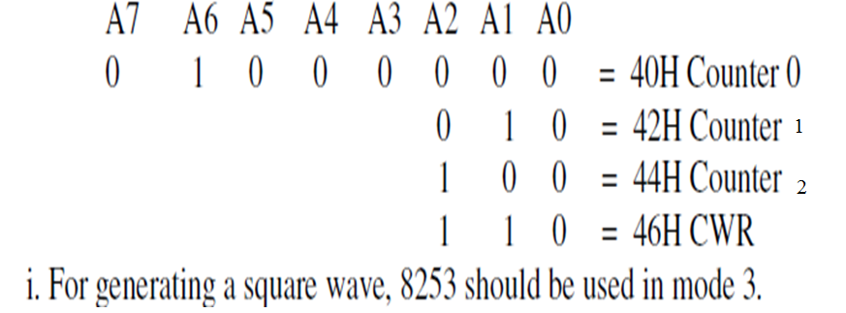

Slide 38
A7 A6 A5 A4 A3 A2 A1 A0
0 1 0 0 0 0 0 0 40
0 1 0 0 0 0 1 0 42
0 1 0 0 0 1 0

Slide 39
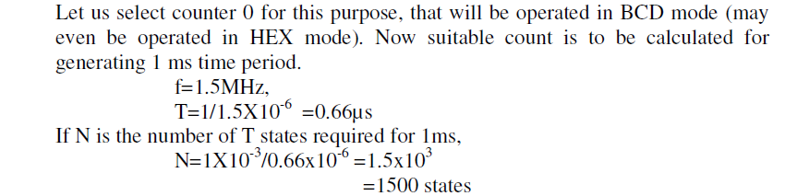

Slide 40
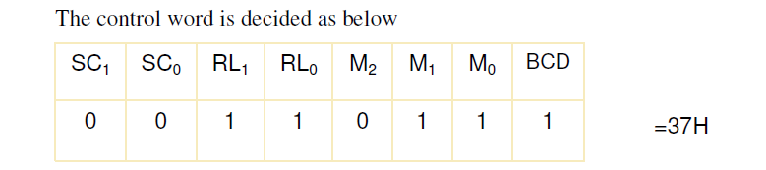

Slide 41
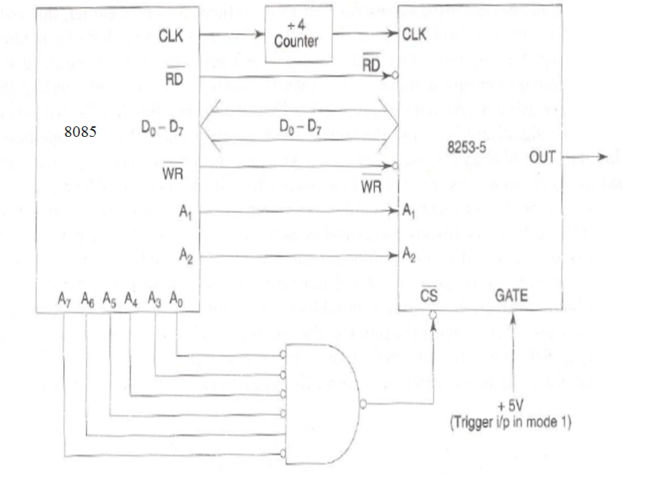

Slide 42
MVI A, 37H
OUT 46H
MVI A,00H
OUT 40H
MVI A,15H
OUT 40H
HLT

Slide 43
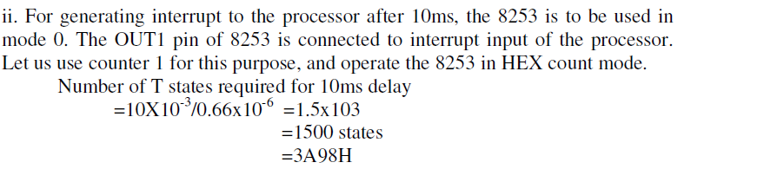

Slide 44
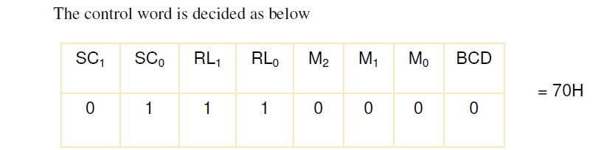

Slide 45
MVI A, 70H
OUT 46H
MVI A ,98H
OUT 42H
MVI A,3AH
OUT 42H
HLT

Slide 46
MVI A,70H
OUT 46H
MVI A,,98H
OUT 42H
MVI A,13AH
OUT 42H
HLT

Slide 47
iii.
For generating a 5ms quasi stable state duration, the count required is calculated
first.
The counter 2 of 8253 is used in mode 1, to count in binary.
The OUT2 signal normally remains high after the count is loaded, till the trigger is applied.
After the application of trigger signal, the output goes low in the next cycle, count down
starts and whenever the count goes zero the output again goes high.

Slide 48
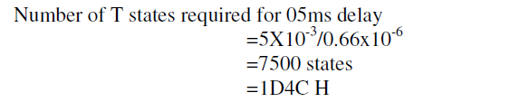

Slide 49
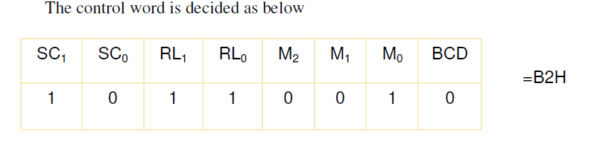

Slide 50
MVI A, B2H
OUT 46H
MVI A ,4CH
OUT 44H
MVI A,1DH
OUT 44H
HLT

Slide 52
8259 A
Programmable Interrupt
controller

Slide 53
8259 Special Features
8086, 8088 Compatible
MCS-80, MCS-85 Compatible
Eight-Level Priority Controller
Expandable to 64 Levels
Programmable Interrupt Modes
Individual Request Mask Capability

Slide 54
Interrupts in Microcomputer System
Microcomputer system design requires I.O devices such as keyboards, displays, sensors and other components
I.O devices should receive servicing in an efficient manner so that large amounts of the total system tasks can be done by the microcomputer with little or no effect on throughput

Slide 55
General Method :Polled Method
The most common method of servicing such devices is the Polled approach.
This is where the processor must test each device in sequence and in effect ``ask'' each one if it needs servicing.
It is easy to see that a large portion of the main program is looping through this continuous polling cycle and hence serious effect on system throughput,

Slide 56
A More Reliable Method : Interrupt
the microprocessor is executing its main program and only stop to service peripheral devices when it is told to do so by the device itself or been interrupted.
Once this servicing is complete, however, the processor would resume exactly where it left off

Slide 57
What is PIC & Why should we go for it ?
The Programmable Interrupt Controller (PIC) functions as an overall manager in an Interrupt-Driven system environment.
It accepts
-requests from the peripheral equipment,
-determines which of the incoming requests is of the
highest importance (priority),
-ascertains whether the incoming request has a higher
priority value than the level currently being serviced,
- issues an interrupt to the CPU based on this
determination.
Each peripheral device has subroutine also referred to as a service routine''.
The PIC, after issuing an Interrupt to the CPU, points the Program Counter to the service routine associated with the requesting device.
This pointer is an address in a vectoring table and will often be referred to as vectoring data.

Slide 58
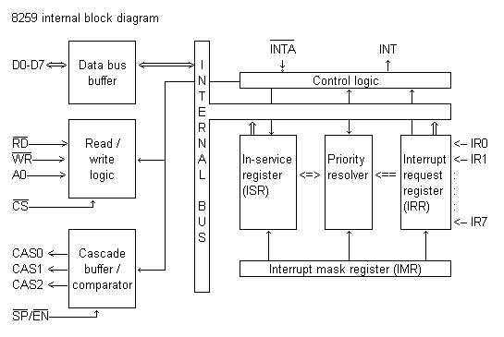
8259A Block Diagram

Slide 59
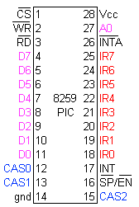
8259 Pin Connections

Slide 60
IRR and ISR
INTERRUPT REQUEST REGISTER (IRR) AND IN-SERVICE REGISTER (ISR)
The interrupts at the IR input lines are handled by two registers in cascade, the Interrupt Request Register (IRR) and the In-Service (ISR).
The IRR is used to store all the interrupt levels which are requesting service; and the ISR is used to store all the interrupt levels which are being serviced.

Slide 61
Priority Resolver
This logic block determines the priorities of the bits set in the IRR.
The highest priority is selected and strobed into the corresponding bit of the ISR during INTA pulse.

Slide 62
Interrupt Mask Register
The IMR stores the bits which mask the interrupt lines to be masked. The IMR operates on the IRR.
Masking of a higher priority input will not affect the interrupt request lines of lower quality.

Slide 63
INT(Interrupt)
This output goes directly to the CPU interrupt input.
The V_{OH} level on this line is designed to be fully compatible with the 8080A, 8085A and 8086 input levels.

Slide 64
INTA(Interrupt Acknowledgement)
INTA pulses will cause the 8259A to release vectoring information onto the data bus. The format of this data depends on the system mode of the 8259A.

Slide 65
Data Bus Buffer
This 3-state, bidirectional 8-bit buffer is used to interface the 8259A to the system Data Bus.
Control words and status information are transferred through the Data Bus Buffer

Slide 66
Read-Write Control Logic
The function of this block is to accept OUTput commands from the CPU.
It contains the Initialization Command Word (ICW) registers and Operation Command Word (OCW) registers which store the various control formats for device operation.
This function block also allows the status of the 8259A to be transferred onto the Data Bus

Slide 67
Chip Select ( CS )
A LOW on this input enables the 8259A. No reading or writing of the chip will occur unless the device is selected
A₀
This input signal is used in conjunction with WR and RD signals to write commands into the various command
registers, as well as reading the various status registers of the chip. This line can be tied directly to one of the address lines

Slide 68
RD & WR
A LOW on WR input enables the CPU to write control words (ICWs and OCWs) to the 8259A.
A LOW on RD input enables the 8259A to send the status of the Interrupt Request Register (IRR), In Service Register (ISR), the Interrupt Mask Register (IMR), or the Interrupt level onto the Data Bus.

Slide 69
8259A Block Diagram (Repeat)

Slide 70
The Cascade Buffer/Comparator
This function block stores and compares the IDs of all 8259A's used in the system. The associated three I/O pins (CAS0-2) are outputs when the 8259A is used as a master and are inputs when the 8259A is used as a slave.
As a master, the 8259A sends the ID of the interrupting slave device onto the CAS 0-2 lines. The slave thus selected will send its preprogrammed subroutine address onto the Data Bus during the next one or two consecutive INTA pulses.

Slide 71
SP/EN (Slave program/Enable buffer) pin is when set to high, works in master mode else in slave mode. In Non Buffered mode, SP/EN pin is used to specify whether 8259 work as master or slave and in Buffered mode, SP/EN pin is used as an output to enable data bus.

Slide 72
INTERRUPT SEQUNCE
The events occur as follows in an MCS-80/85 system:
1. One or more of the INTERRUPT REQUEST lines (IR7-0) are raised high, setting the corresponding IRR bit (s).
2. The 8259A evaluates these requests, and sends an INT to the CPU, if appropriate.
3. The CPU acknowledges the INT and responds with an INTA pulse.
4. Upon receiving an INTA from the CPU group, the highest priority ISR bit is set, and the corresponding IRR bit is reset. The 8259A will also release a CALL instruction code (11001101) onto the 8-bit Data Bus through its D0-7 pins.
5. This CALL instruction will initiate two more INTA pulses to be sent to the 8259A from the CPU group.
6. These two INTA pulses allow the 8259A to release its preprogrammed subroutine address onto the Data Bus. The lower 8-bit address is released at the first INTA pulse and the higher 8-bit address is released at the second INTA pulse.
7. This completes the 3-byte CALL instruction released by the 8259A.

Slide 73
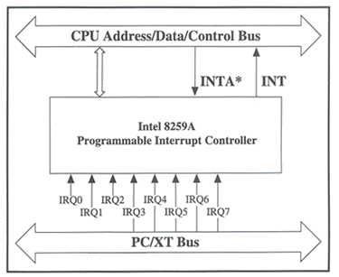
8259 Interface to Standard System Bus

Slide 74
Interrupt Sequence Outputs
This sequence is timed by three INTA pulses. During the first INTA pulse the CALL opcode is enabled onto the data bus.
Content of First Interrupt Vector Byte -
D7 D6 D5 D4 D3 D2 D1 D0
1 1 0 0 1 1 0 1
During the second INTA pulse the lower address of the appropriate service routine is enabled onto the data bus. When Interval = 4 bits A5-A7 are programmed, while A0-A4 are automatically inserted by the 8259A.
When Interval = 8 only A6 and A7 are programmed, while A0-A5 are automatically inserted.

Slide 75
Interrupt Sequence Outputs (Contd.)
IR Interval = 4
D7 D6 D5 D4 D3 D2 D1 D0
7 A7 A6 A5 1 1 1 0 0
6 A7 A6 A5 1 1 0 0 0
5 A7 A6 A5 1 0 1 0 0
4 A7 A6 A5 1 0 0 0 0
3 A7 A6 A5 0 1 1 0 0
2 A7 A6 A5 0 1 0 0 0
1 A7 A6 A5 0 0 1 0 0
0 A7 A6 A5 0 0 0 0 0
IR Interval = 8
D7 D6 D5 D4 D3 D2 D1 D0
7 A7 A6 1 1 1 0 0 0
6 A7 A6 1 1 0 0 0 0
5 A7 A6 1 0 1 0 0 0
4 A7 A6 1 0 0 0 0 0
3 A7 A6 0 1 1 0 0 0
2 A7 A6 0 1 0 0 0 0
1 A7 A6 0 0 1 0 0 0
0 A7 A6 0 0 0 0 0 0

Slide 76
Interrupt Sequence Outputs (Contd.)
During the third INTA pulse the higher address of the appropriate service routine, which was programmed as byte 2 of the initialization sequence (A8-A15), is enabled onto the bus.
Content of Third Interrupt Vector Byte
D7 D6 D5 D4 D3 D2 D1 D0
A15 A14 A13 A12 A11 A10 A9 A8

Slide 77
PROGRAMMING THE 8259A
The 8259A accepts two types of command words generated by the CPU:
1. Initialization Command Words (ICWs): Before normal operation can begin, each 8259A in the system must be brought to a starting point by a Sequence of 2 to 4 bytes timed by WR pulses.
2. Operation Command Words (OCWs): These are the command words which command the 8259Ato operate in various interrupt modes.
These modes are:
a. Fully nested mode
b. Rotating priority mode
c. Special mask mode
d. Polled mode
The OCWs can be written into the 8259A anytime after initialization.

Slide 78
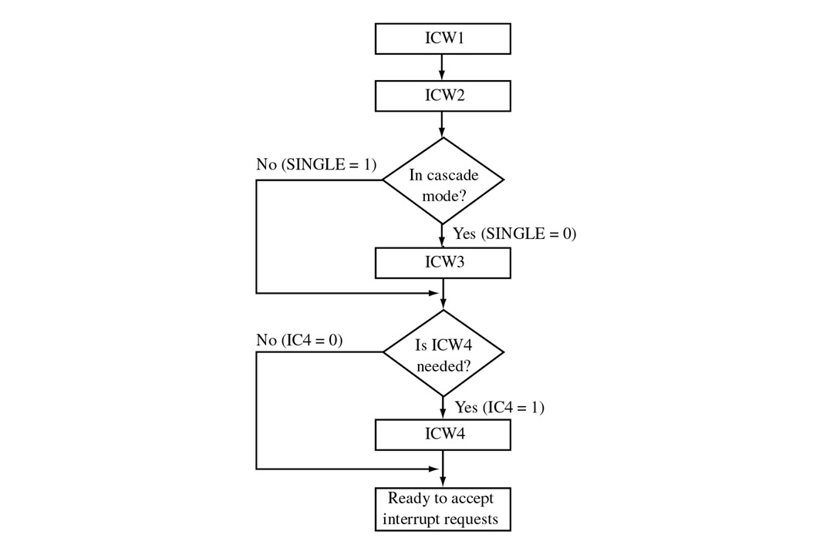
Initialization Command Words

Slide 79
ICW Format
ICW 1:
A0 D0 D1 D2 D3 D4 D5 D6 D7
0 A7 A6 A5 1 LTIM ADI SNGL IC 4
IC4=1 ICW4 needed
IC4=0 ICW4 not needed
SNGL=1 Single SNGL=0 Cascade Mode
LTIM=1 Level Triggered Mode
LTIM=0 Edge Triggered Mode
A5-A7 Vector Addresses

Slide 80
ICW Format ( contd.)
ICW 2:
A0 D0 D1 D2 D3 D4 D5 D6 D7
1 A15/T7 A14/T6 A13/T5 A12/T4 A11/T3 A10 A9 A8
A8 – A15
(VECTOR ADDRESSES in case of MCS 80/85 system)
T3-T7
(VECTOR ADDRESSES in case of MCS 8086/8088 system)

Slide 81
ICW Format (contd.)
ICW 3: (MASTER MODE)
A0 D0 D1 D2 D3 D4 D5 D6 D7
1 S7 S6 S5 S4 S3 S2 S1 S0
S0 – S7 = 1, IR input has a slave
= 0, IR input does not have a slave
ICW 3: (SLAVE MODE)
A0 D0 D1 D2 D3 D4 D5 D6 D7
1 0 0 0 0 0 ID2 ID1 ID0
ID0-2 = Slave IDs

Slide 82
Operation Command Words (OCW)
OCW1:-
A0 D7 D6 D5 D4 D3 D2 D2 D1 D0
1 M7 M6 M5 M4 M4 M3 M2 M1 M0
Interrupt Mask = 1 Mask Set
= 0 Mask Reset

Slide 83
Operation Command Words (OCW) (contd.)
OCW 2:-
A0 D7 D6 D5 D4 D3 D2 D1 D0
0 R SL EOI 0 0 L2 L1 L0
0 0 1 - Non-Specific EOI Command
0 1 1 - Specific EOI Command
1 0 1 - Rotate on Non-Specific EOI Command
1 0 0 - Rotate in automatic EOI mode (Set)
0 0 0 - Rotate in automatic EOI mode (Clear)
1 1 1 - Rotate on Specific EOI command
1 1 0 - Set Priority Command
0 1 0 - No Operation
L0 – L2 = IR Level to be acted upon

Slide 84
Operation Command Words (OCW) (contd.)
OCW 3 :-
A0 D7 D6 D5 D4 D3 D2 D1 D0
0 0 ESMM SMM 0 1 P RR RIS
No Action 0 0
No Action 0 1
Read IR reg. on next RD pulse 1 0
Read IR reg. on next RD pulse 1 1
P =1 Poll Command
=0 No Poll Command
ESMM SMM
0 0 No Action
0 1 No Action
1 0 Reset Special Mask
1 1 Set Special Mask

Slide 85
OCW Description :-
OCW 3 :-
ESMM (Enable Special Mask Mode) - When this bit is set to 1 it enables the SMM bit to set or reset the Special Mask Mode. When ESMM e 0 the SMM bit becomes a ``don't care''.
SMM (Special Mask Mode) - If ESMM = 1 and SMM = 1 the 8259A will enter Special Mask Mode. If ESMM = 1 and SMM = 0 the 8259A will revert to normal mask mode. When ESMM = 0, SMM has no effect.

Slide 86
Fully Nested Mode
This mode is entered after initialization unless another mode is programmed. The interrupt requests are ordered in priority from 0 through 7 (0 highest). When an interrupt is acknowledged the highest priority request is determined and its vector placed on the bus. Additionally, a bit of the Interrupt Service register (ISO-7) is set. This bit remains set until the microprocessor issues an End of Interrupt (EOI) command immediately before returning from the service routine, or if AEOI (Automatic End of Interrupt) bit is set, until the trailing edge of the last INTA. While the IS bit is set, all further interrupts of the same or lower priority are inhibited, while higher levels will generate an interrupt (which will be acknowledged only if the microprocessor internal Interrupt enable flip-flop has been re-enabled through software).
After the initialization sequence, IR0 has the highest prioirity and IR7 the lowest. Priorities can be changed, as will be explained, in the rotating priority mode.

Slide 87
EOI (End Of Interrupt)
The In Service (IS) bit can be reset either automatically following the trailing edge of the last in sequence INTA pulse (when AEOI bit in ICW1 is set) or by a command word that must be issued to the 8259A before returning from a service routine (EOI command). An EOI command must be issued twice if in the Cascade mode, once for the master and once for the corresponding slave.
There are two forms of EOI command: Specific and Non-Specific. When the 8259A is operated in modes which preserve the fully nested structure, it can determine which IS bit to reset on EOI. When a Non-Specific EOI command is issued the 8259A will automatically reset the highest IS bit of those that are set, since in the fully nested mode the highest IS level was necessarily the last level acknowledged and serviced. A non-specific EOI can be issued with OCW2 (EOI = 1, SL = 0, R = 0).
When a mode is used which may disturb the fully nested structure, the 8259A may no longer be able to determine the last level acknowledged.
In this case a Specific End of Interrupt must be issued which includes as part of the command the IS level to be reset.
A specific EOI can be issued with OCW2 (EOI =1, SL=1, R= 0, and L0-L2 is the binary level of the IS bit to be reset).
It should be noted that an IS bit that is masked by an IMR bit will not be cleared by a non-specific EOI if the 8259A is in the Special Mask Mode.

Slide 88
Automatic End of Interrupt (AEOI) Mode
If AEOI =1 in ICW4, then the 8259A will operate in AEOI mode continuously until reprogrammed by ICW4 , in this mode the 8259A will automatically perform a non-specific EOI operation at the trailing edge of the last interrupt acknowledge pulse (third pulse in MCS-80/85, second in 8086).
Note that from a system standpoint, this mode should be used only when a nested multilevel interrupt structure is not required within a single 8259A.
The AEOI mode can only be used in a master 8259A
and not a slave. 8259As with a copyright date of 1985 or later will operate in the AEOI mode as a master or a slave.

Slide 89
AUTOMATIC ROTATION
In some applications there are a number of interrupting devices of equal priority. In this mode a device, after being serviced, receives the lowest priority, so a device requesting an interrupt will have to wait, in the worst case until each of 7 other devices are serviced at most once . For example, if the priority and ``in service'' status is:
Before Rotate (IR4 the highest priority requiring service) :-
IS7 IS6 IS5 IS4 IS3 IS2 IS1 IS0
0 1 0 1 0 0 0 0 IS STATUS
7 6 5 4 3 2 1 0 Priority Status
After Rotate (IR4 the highest priority requiring service) :-
IS7 IS6 IS5 IS4 IS3 IS2 IS1 IS0
0 1 0 0 0 0 0 0 IS STATUS
2 1 0 7 6 5 4 3 Priority Status

Slide 90
Specific Rotation (Specific Priority)
The programmer can change priorities by programming the bottom priority and thus fixing all other priorities ;i.e., if IR5 is programmed as the bottom priority device, then IR6 will have the highest one.
The Set Priority command is issued in OCW2 where: R=1, SL=1, L0-L2 is the binary priority level code of the bottom priority device.
Observe that in this mode internal status is updated by software control during OCW2.
However, it is independent of the End of Interrupt (EOI) command (also executed by OCW2).
Priority changes can be executed during an EOI command by using the Rotate on Specific EOI command in OCW2 (R=1, SL=1, EOI=1 and LO-L2 IR level to receive bottom priority).

Slide 91
INTERRUPT MASK
Each Interrupt Request input can bem masked individually by the Interrupt Mask Register (IMR) programmed through OCW1. Each bit in the IMR masks one interrupt channel if it is set (1). Bit 0 masks IR0,Bit 1 masks IR1 and so forth. Masking an IR channel does not affect the other channels operation.
SPECIAL MASK MODE
Some applications may require an interrupt service routine to dynamically alter the system priority structure during its execution under software control. For example, the routine may wish to inhibit lower priority requests for a portion of its execution but enable some of them for another portion.
The difficulty here is that if an Interrupt Request is acknowledged and an End of Interrupt command did not reset its IS bit (i.e., while executing a service routine), the 8259A would have inhibited all lower priority requests with no easy way for the routine to enable them. That is where the Special Mask Mode comes in. In the special Mask Mode, when a mask bit is set in
OCW1, it inhibits further interrupts at that level and Enables interrupts from all other levels (lower as well as higher) that are not masked. Thus, any interrupts may be selectively enabled by loading the mask register.
The special Mask Mode is set by OWC3 where:
SSMM =1, SMM =1, and cleared where SSMM =1, SMM = 0.

Slide 92
POLL COMMAND
In Poll mode the INT output functions as it normally does. The microprocessor should ignore this output. This can be accomplished either by not connecting the INT output or by masking interrupts within the microprocessor, thereby disabling its interrupt input. Service to devices is achieved by software using a Poll command. The Poll command is issued by setting P = `1'' in OCW3. The 8259A treats the next RD pulse to the 8259A (i.e., RD e 0, CS e 0) as an interrupt acknowledge, sets the appropriate IS bit if there is a request, and reads the priority level. Interrupt is frozen from WR to RD. The word enabled onto the data bus during RD is:
D7 D6 D5 D4 D3 D2 D1 D0
I - - - - w2 w1 w0
W0 - W2: Binary code of the highest priority level requesting service.
I : Equal to ``1'' if there is an interrupt.
This mode is useful if there is a routine command common to several levels so that the INTA sequence is not needed (saves ROM space). Another application is to use the poll mode to expand the number of priority levels to more than 64.

Slide 93
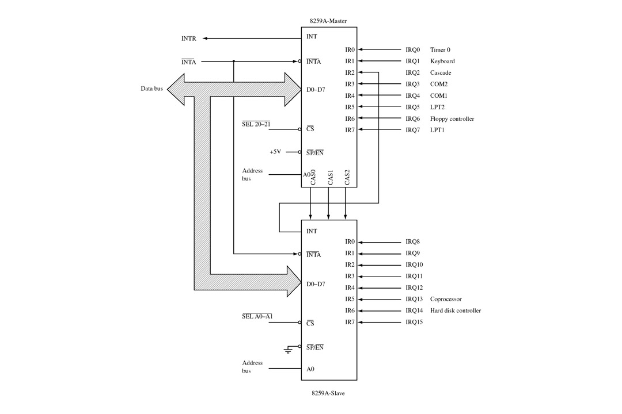
CASCADE MODE

Slide 94
CASCADE MODE (contd.)
The 8259A can be easily interconnected in a system of one master with up to eight slaves to handle up to 64 priority levels.
The master controls the slaves through the 3 line cascade bus. The cascade bus acts like chip selects to the slaves during the INTA sequence.
In a cascade configuration, the slave interrupt outputs are connected to the master interrupt request inputs. When a slave request line is activated and afterwards acknowledged, the master will enable the corresponding slave to release the device routine address during bytes 2 and 3 of INTA. (Byte 2 only for 8086/8088).
The cascade bus lines are normally low and will contain the slave address code from the trailing edge of the first INTA pulse to the trailing edge of the third pulse. Each 8259A in the system must follow a separate initialization sequence and can be programmed to work in a different mode. An EOI command must be issued twice: once for the master and once for the corresponding slave. An address decoder is required to activate the Chip Select (CS) input of each 8259A.
The cascade lines of the Master 8259A are activated only for slave inputs, non-slave inputs leave the cascade line inactive (low).

Slide 95
The Special Fully Nested Mode
This mode will be used in the case of a big system where cascading is used, and the priority has to be conserved within each slave. In this case the fully nested mode will be programmed to the master (using ICW4). This mode is similar to the normal nested mode with the following exceptions:
A) When an interrupt request from a certain slave is in service this slave is not locked out from the master's priority logic and further interrupt requests from higher priority IR's within the slave will be recognized by the master and will initiate interrupts to the processor. (In the normal nested mode a slave is masked out when its request is in service and no higher requests from the same slave can be serviced.)
B) When exiting the Interrupt Service routine the software has to check whether the interrupt serviced was the only one from that slave. This is done by sending a non-specific End of Interrupt (EOI) command to the slave and then reading its In-Service register and checking for zero. If it is empty, a non-specific EOI can be sent to the master too. If not, no EOI should be sent.

Slide 96
Buffered Mode
When the 8259A is used in a large system where bus driving buffers are required on the data bus and the cascading mode is used, there exists the problem of enabling buffers.
The buffered mode will structure the 8259A to send an enable signal on SP/EN to enable the buffers. In this mode, whenever the 8259A's data bus outputs are enabled, the SP/EN output becomes active.
This modification forces the use of software programming to determine whether the 8259A is a master or a slave. Bit 3 in ICW4 programs the buffered mode, and bit 2 in ICW4 determines whether it is a master or a slave.

Slide 97
DMA CONTROLLER 8257
Features:
It is a 4-channel DMA.
So 4 I/O devices can be interfaced to DMA
It is designed by Intel
Each channel have 16-bit address and 14 bit counter
It provides chip priority resolver that resolves priority of channels in fixed or rotating mode.
It provide on chip channel inhibit logic.

Slide 98
It generates a TC signal to indicate the peripheral that the programmed number of data bytes have been transferred.
It generates MARK signal to indicate the peripheral that 128 bytes have been transferred.
It requires single phase clock. The maximum frequency is 3Mhz and minimum frequency is 250 Hz.
It execute 3 DMA cycles
1.DMA read 2.DMA write 3.DMA verify.
It provide AEN signal that can be used to isolate CPU and other devices from the system bus.
It is operate in two modes.
1.Master Mode
2.Slave Mode

Slide 99
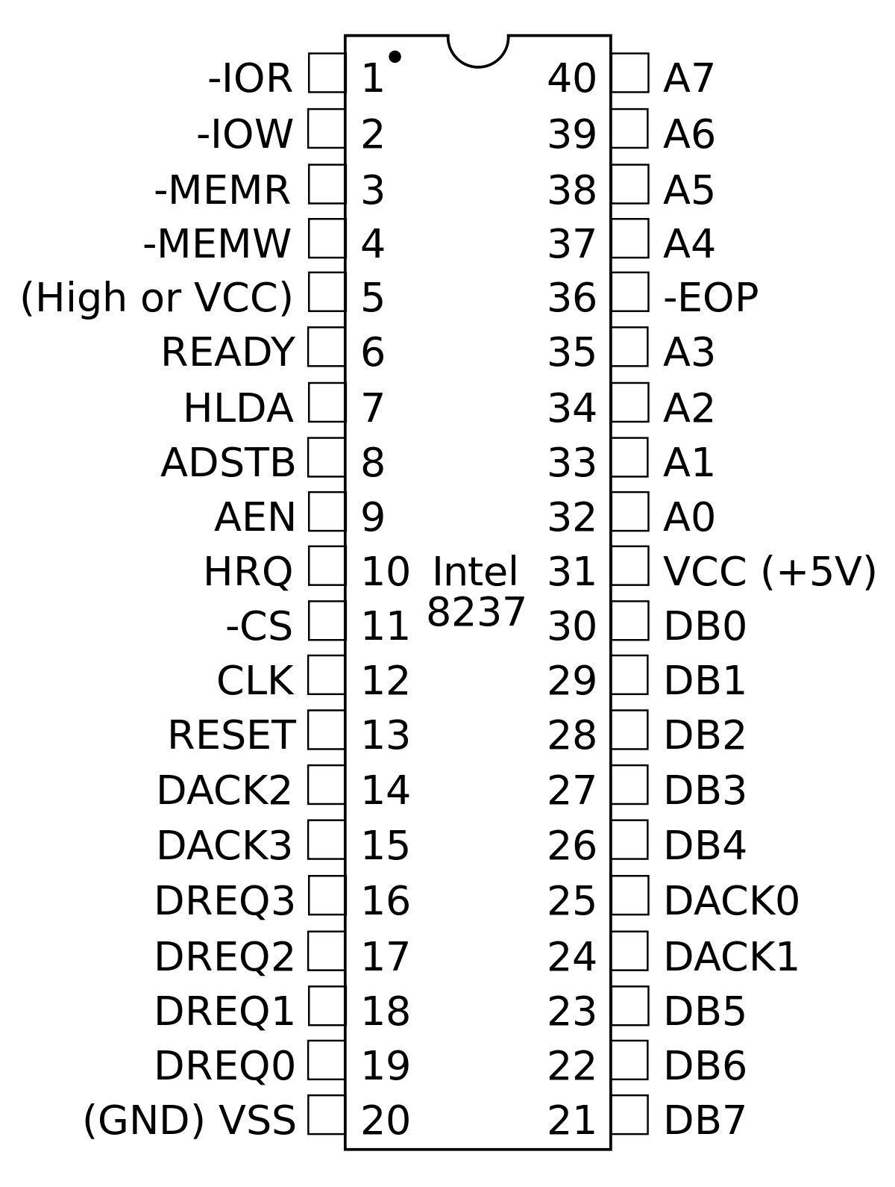
Pin Diagram of DMA controller

Slide 100
Description of pin diagram
D0-D7:
it is a bidirectional ,tri state ,Buffered ,Multiplexed data (D0-D7)and (A8-A15).
In the slave mode it is a bidirectional (Data is moving).
In the Master mode it is a unidirectional (Address is moving).

Slide 101
IOR:
It is active low ,tristate ,buffered ,Bidirectional lines.
In the slave mode it function as a input line. IOR signal is generated by microprocessor to read the contents 8257 registers.
In the master mode it function as a output line. IOR signal is generated by 8257 during write cycle

Slide 102
IOW:
It is active low ,tri state ,buffered ,Bidirectional control lines.
In the slave mode it function as a input line. IOR signal is generated by microprocessor to write the contents 8257 registers.
In the master mode it function as a output line. IOR signal is generated by 8257 during read cycle

Slide 103
CLK:
It is the input line ,connected with TTL clock generator.
This signal is ignored in slave mode.
RESET:
Used to clear mode set registers and status registers
A0-A3:
These are the tristate, buffer, bidirectional address lines.
In slave mode ,these lines are used as address inputs lines and internally decoded to access the internal registers.
In master mode, these lines are used as address outputs lines,A0-A3 bits of memory address on the lines.

Slide 104
CS:
It is active low, Chip select input line.
In the slave mode, it is used to select the chip.
In the master mode, it is ignored.
A4-A7:
These are the tristate, buffer, output address lines.
In slave mode ,these lines are used as address outputs lines.
In master mode, these lines are used as address outputs lines,A0-A3 bits of memory address on the lines.

Slide 105
READY:
It is a asynchronous input line.
In master mode,
When ready is high it is received the signal.
When ready is low, it adds wait state between S1 and S3
In slave mode ,this signal is ignored.
HRQ:
It is used to receiving the hold request signal from the output device.

Slide 106
HLDA:
It is acknowledgment signal from microprocessor.
MEMR:
It is active low ,tristate ,Buffered control output line.
In slave mode, it is tristated.
In master mode ,it activated during DMA read cycle.
MEMW:
It is active low ,tristate ,Buffered control input line.
In slave mode, it is tristated.
In master mode ,it activated during DMA write cycle.

Slide 107
AEN (Address enable):
It is a control output line.
In master mode ,it is high
In slave mode ,it is low
Used it isolate the system address ,data ,and control lines.
ADSTB: (Address Strobe)
It is a control output line.
Used to split data and address line.
It is working in master mode only.
In slave mode it is ignore.

Slide 108
TC (Terminal Count):
It is a status of output line.
It is activated in master mode only.
It is high ,it selected the peripheral.
It is low ,it free and looking for a new peripheral.
MARK:
It is a modulo 128 MARK output line.
It is activated in master mode only.
It goes high ,after transferring every 128 bytes of data block.

Slide 109
DRQ0-DRQ3(DMA Request):
These are the asynchronous peripheral request input signal.
The request signals is generated by external peripheral device.
DACK0-DACK3:
These are the active low DMA acknowledge output lines.
Low level indicate that ,peripheral is selected for giving the information (DMA cycle).
In master mode it is used for chip select.

Slide 110
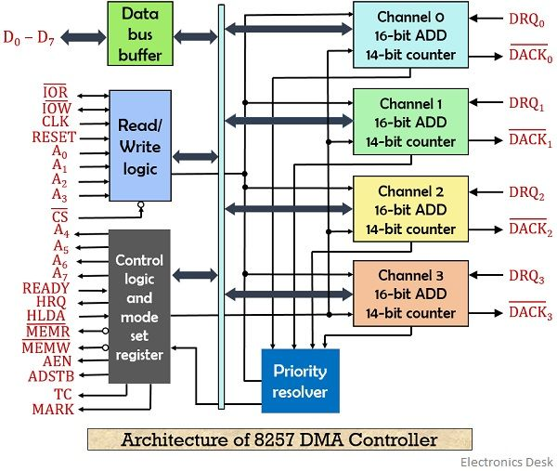
8257 BLOCK DIAGRAM

Slide 111
Description
It containing Five main Blocks.
Data bus buffer
Read/Control logic
Control logic block
Priority resolver
DMA channels.

Slide 112
DATA BUS BUFFER:
It contain tristate ,8 bit bi-directional buffer.
Slave mode ,it transfer data between microprocessor and internal data bus.
Master mode ,the outputs A8-A15 bits of memory address on data lines (Unidirectional).
READ/CONTROL LOGIC:
It control all internal Read/Write operation.
Slave mode ,it accepts address bits and control signal from microprocessor.
Master mode ,it generate address bits and control signal.

Slide 113
Control logic block:
It contains ,
Control logic
Mode set register and
Status Register.
CONTROL LOGIC:
Master mode ,It control the sequence of DMA operation during all DMA cycles.
It generates address and control signals.
It increments 16 bit address and decrement 14 bit counter registers.
It activate a HRQ signal on DMA channel Request.
Slave ,mode it is disabled.

Slide 114
MODE SET REGISTERS:
It is a write only registers.
It is used to set the operating modes.
This registers is programmed after initialization of DMA channel.
D₇ | D₆ | D₅ | D₄ | D₃ | D₂ | D₁ | D₀
AL | TCS | EW | RP | EN₃ | EN₂ | EN₁ | EN₀

Slide 115
AL=1=Auto load mode
AL=0=Rotating mode
TCS=1=Stop after TC (Disable Channel)
TCS=0=Start after TC (Enable Channel)
EW=1=Extended write mode
EW=0=normal mode.
RP=1=Rotating priority
RP=0=Fixed priority.

Slide 116
EN₃=1=Enable DMA CH-3
EN₃=0=Disable DMA CH-3
EN₂=1=Enable DMA CH-2
EN₂=0=Disable DMA CH-2
EN₁=1=Enable DMA CH-1
EN₁=0=Disable DMA CH-1
EN₀=1=Enable DMA CH-0
EN₀=0=Disable DMA CH-0

Slide 117
STATUS REGISTERS:
It is read only registers.
It is tell the status of DMA channels
TC status bits are set when TC signal is activated for that channel.
Update flag is not affected during read operation.
The UP bit is set during update cycle . It is cleared after completion of update cycle.
D₇ | D₆ | D₅ | D₄ | D₃ | D₂ | D₁ | D₀
0 | 0 | 0 | UP | TC₃ | TC₂ | TC₁ | TC_{O}

Slide 118
UP=Update flag
UP=1=8257 executing update cycle
UP=0=8257 executing DMA cycle
TC₃=1=TC activated CH-3
TC₃=0=TC activated CH-3
TC₂=1=TC activated CH-2
TC₂=0=TC activated CH-2

Slide 119
TC₁=1=TC activated CH-1
TC₁=0=TC activated CH-1
TC₀=1=TC activated CH-0
TC₀=0=TC activated CH-0
The address of status register is A₃A₂A₁A₀=1000.
FIRST/LAST FLIP FLOP:
8257 have 8bit data line and 16 bit address line.
8085 it is getting 8-bit data in simultaneously.
8085 can not access 16-bit address in simultaneously.

Slide 120
A0-A3 lines are used to distinguish between registers ,but they are not distinguish lower and higher address.
It is reset by external RESET signal.
It is also reset by whenever mode set register is loaded.
So program initialization with a dummy (00 H).
FF=1=Higher byte of address
FF=0=Lower byte of address.

Slide 121
Modes of Operation
Rotating priority Mode:
The priority of the channels has a circular sequence.
Fixed Priority Rotating Mode:
The priority is fixed.
TC Stop Mode
Auto Load mode
Extended Write mode

Slide 122
DMA Cycles
DMA read:
DMA write
DMA Verify

